Slide 1
Railway Ticket Booking

Slide 2
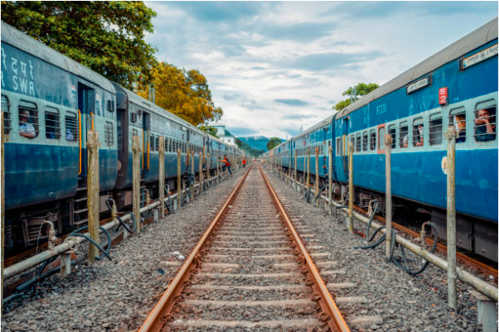
Outline
Introduction
Objective
Description Of Modules
Future Enhancements
Conclusion

Slide 3

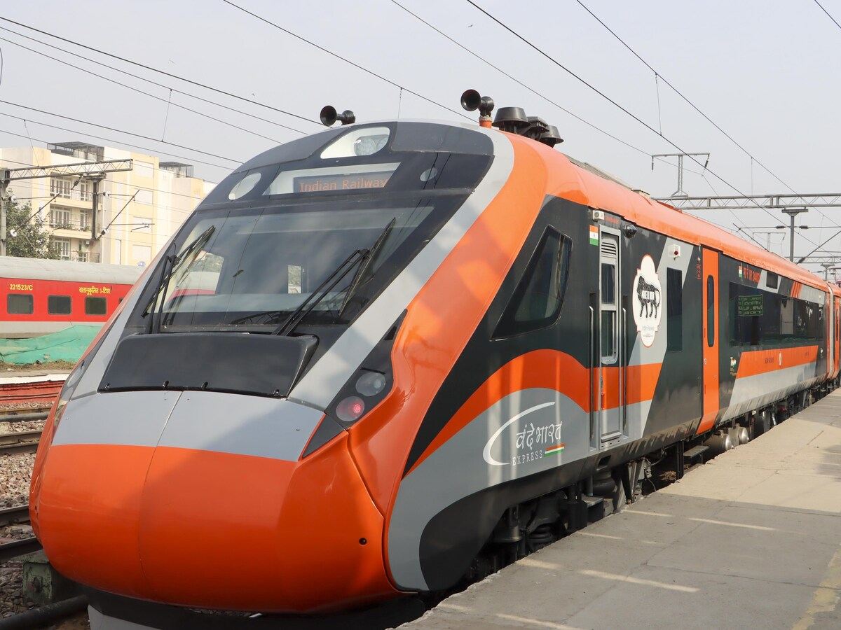
Introduction

Slide 4
Railway reservation systems are widely used real-time applications that require accuracy, efficiency, and proper handling of shared resources such as seat availability. Manual ticket booking systems are error-prone and inefficient, making automation essential.
This project presents a Java-based Railway Ticket Booking System with a Graphical User Interface (GUI) developed using Swing and AWT components. The system supports multiple coaches, dynamic seat allocation, passenger-based ticket generation, and cancellation functionality.
The application is designed to be user-friendly, modular, and scalable, making it suitable for understanding how real-world booking systems function while applying core Java programming concepts such as inheritance, polymorphism, encapsulation, synchronization, collections, and event handling.

Slide 5

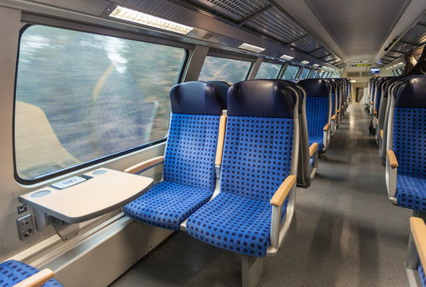
Objective

Slide 6
The objective of this project is to design and implement a Railway Ticket Booking System using Java Swing that simulates real-world railway reservation operations. The system allows users to:
Select source and destination stations
Choose different classes of coaches
View seat availability
Book tickets with passenger details
Calculate ticket fare based on age and coach type
Cancel booked tickets
View booked tickets in a printable ticket format
The project aims to demonstrate the effective application of Object-Oriented Programming (OOP) concepts, GUI development using Java Swing, and thread-safe booking mechanisms

Slide 7
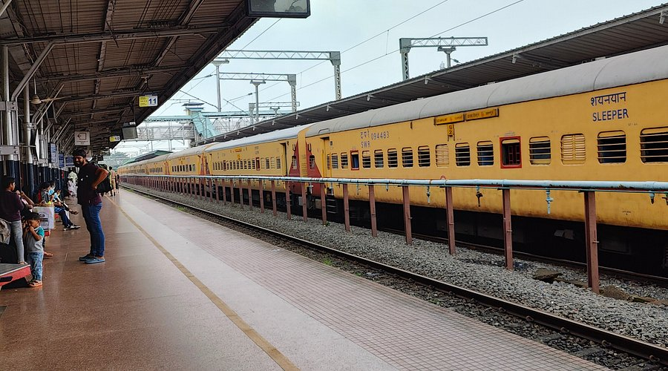
Description Of Modules

Slide 8
Modules
Main Menu Module
Entry point of the application
Provides navigation to booking, cancellation, and ticket viewing
Booking Module
Coach selection
Station selection
Seat availability display
Seat selection
Passenger Module
Passenger name and age input
Validation of passenger data
Ticket Module
Ticket generation
Ticket storage
Fare calculation
Cancellation Module
Ticket cancellation using seat ID
Seat availability restoration
View Tickets Module
Display of booked tickets
Printable ticket-style layout

Slide 9
Block Diagram
User
│
▼
Main Menu
│
├── Book Ticket
│ ├── Select Coach & Stations
│ ├── Select Seats
│ ├── Enter Passenger Details
│ └── Generate Ticket
│
├── Cancel Ticket
│ └── Free Seat & Remove Ticket
│
└── View Tickets
└── Display Printable

Slide 10
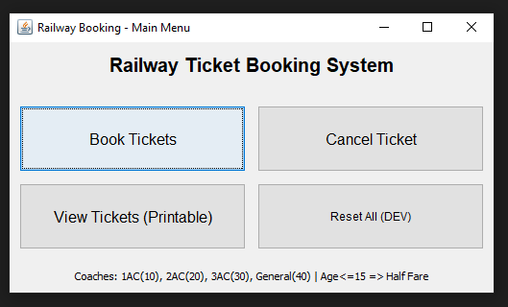
Main Menu Module
Requirement & Functionality
Acts as the central control of the application
Displays options for booking, cancellation, viewing tickets, and resetting data
Java Techniques Used
Swing components (JFrame, JButton, JLabel)
Event handling using ActionListener
Layout managers (BorderLayout, GridLayout)

Slide 11
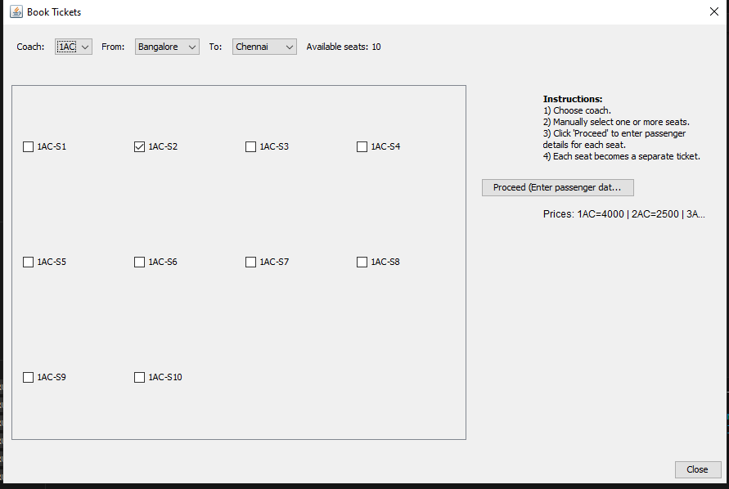
Ticket Booking Module
Requirement & Functionality
Allows user to select:
Coach type (1AC, 2AC, 3AC, GEN)
Source and destination stations
Displays seat availability dynamically
Supports booking of multiple seats at once
Java Techniques Used
Swing components (JDialog, JComboBox, JCheckBox)
Java Collections (Map, List)
Java Streams (stream(), filter(), collect())
Validation using conditional checks

Slide 12
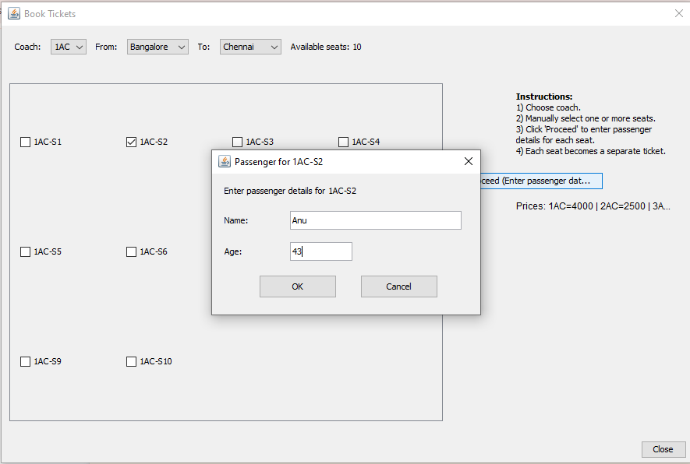
Passenger Details Module
Requirement & Functionality
Collects passenger name and age
Performs validation for empty input and invalid age
Confirms booking per passenger
Java Techniques Used
Modal dialogs (JDialog)
Exception handling (NumberFormatException)
Encapsulation of passenger data
Input validation logic

Slide 13
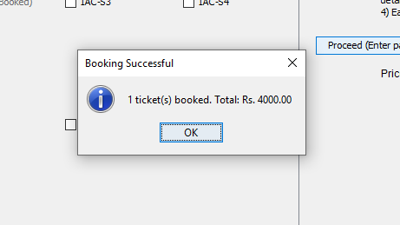
Ticket Management Module
Requirement & Functionality
Generates unique ticket IDs
Stores ticket details
Calculates fare based on:
Coach type
Passenger age (half fare for age ≤ 15)
Java Techniques Used
Encapsulation using Ticket and BaseTicket classes
Java Date & Time (Date, SimpleDateFormat)
Use of HashMap and ArrayList

Slide 14
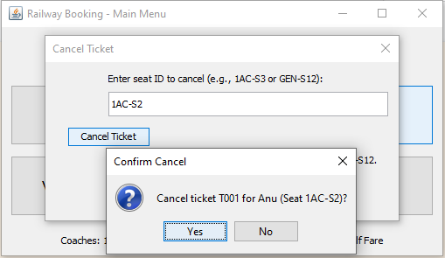
Ticket Cancellation Module
Requirement & Functionality
Cancels ticket using seat ID
Frees the seat for future booking
Removes ticket from system
Java Techniques Used
Swing dialogs
Map lookups
Confirmation dialogs
Collection modification

Slide 15
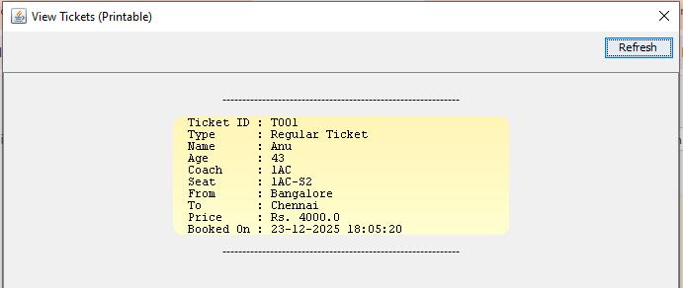
Ticket Viewing Module
Requirement & Functionality
Displays all booked tickets
Printable ticket-style layout
Shows all ticket details clearly
Java Techniques Used
Custom painting using paintComponent()
Graphics2D, GradientPaint
Swing layouts (BoxLayout, JScrollPane)

Slide 16
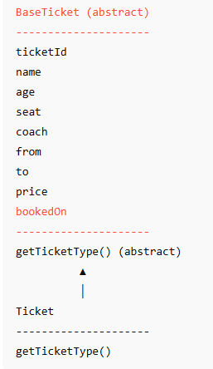
OOP Design
Inheritance
Ticket class extends abstract class BaseTicket
abstract class BaseTicket class Ticket extends BaseTicket
Polymorphism
Abstract method getTicketType() implemented in subclass
Method called dynamically while displaying ticket details
Encapsulation
Ticket-related data bundled inside classes
Accessed through controlled methods

Slide 17
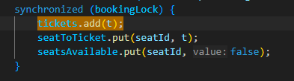
Synchronization and Thread Safety
Requirement & Functionality
Prevents inconsistent seat booking
Ensures data integrity when multiple operations occur
Java Techniques Used
Synchronization using:
synchronized (bookingLock)
Thread-safe access to shared resources

Slide 18
Booking Flow
Passenger Dialog Opened
│
▼
Age Validation
│
▼
Price Calculation
│
▼
Ticket Object Created
│
▼
Seat Locked using synchronized block
│
▼
Ticket Stored Successfully
User selects Book Ticket
│
▼
Coach Selected
│
▼
Seats Loaded from Map
│
▼
Seat Availability Checked
│
▼

Slide 19
Synchronization Flow
Multiple Booking Requests
│
▼
Access Shared Data
│
▼
synchronized(bookingLock)
│
▼
Update seatsAvailable
│
▼
Update seatToTicket
│
▼
Update tickets list
│
▼
Release Lock

Slide 20
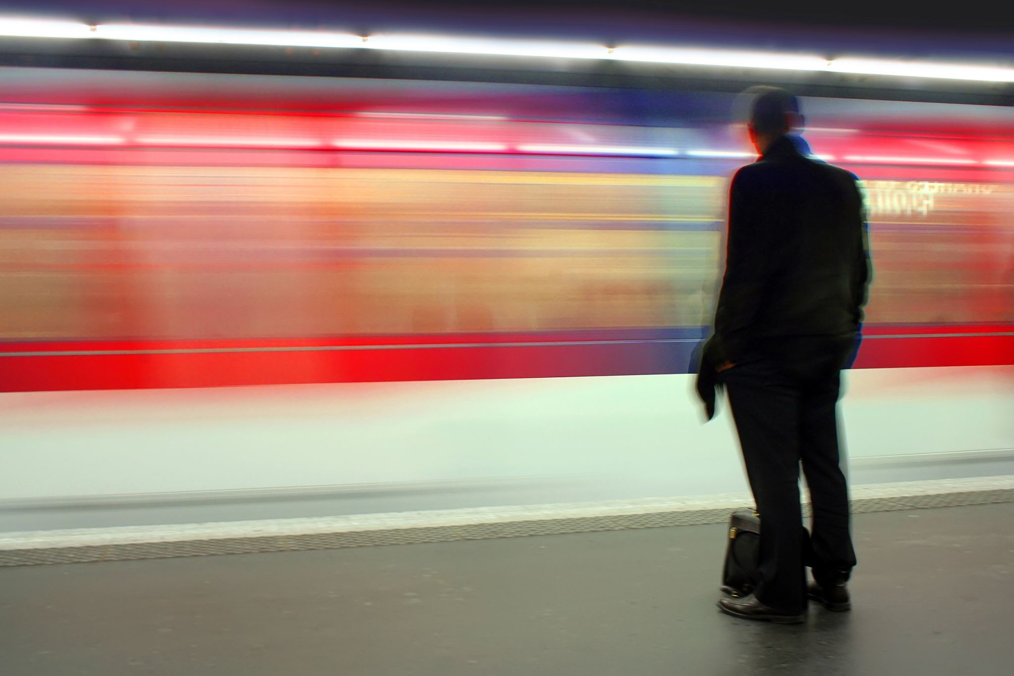

Future Enhancements

Slide 21
Although the current system meets the core requirements, several enhancements can be implemented to improve functionality and scalability.
Database Integration The system can be enhanced by integrating a database such as MySQL or PostgreSQL to store ticket and passenger data permanently instead of using in-memory collections.
User Authentication Login and registration modules can be added to allow multiple users to book and manage their tickets securely.
Multiple Ticket Types Additional ticket types such as Tatkal, Senior Citizen, or Student tickets can be introduced to demonstrate stronger polymorphism.
Online Payment Gateway A payment module can be added to support digital transactions such as UPI, debit, or credit card payments.

Slide 22
conclusion
Successfully developed a GUI-based Railway Ticket Booking System using Java
Implemented Object-Oriented Programming concepts such as:
Encapsulation
Inheritance
Polymorphism
Abstraction
Designed an interactive interface using Java Swing & AWT
Ensured thread safety using synchronization to avoid seat conflicts
Improved understanding of real-world application design, event handling, and collections
This project strengthened practical knowledge of Java and OOP concepts through a real-time application.

Slide 23
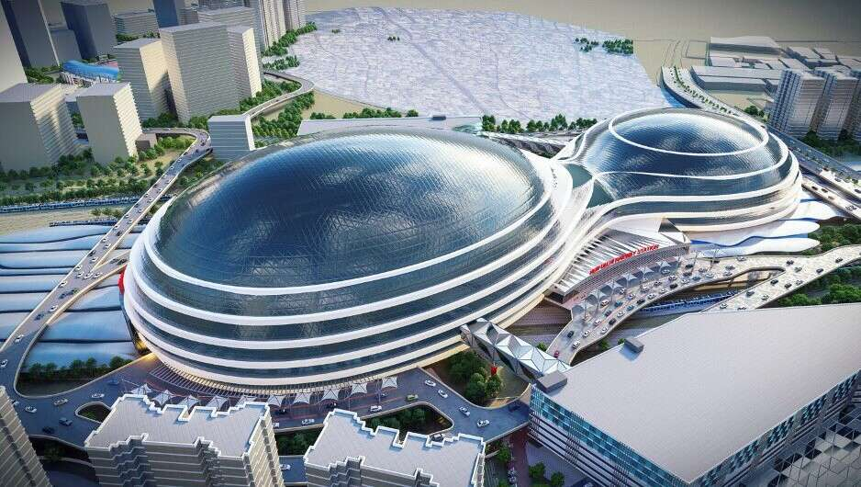
THANK YOU
Pooja Basavaraj Kuruvinakoppa(1BM24CS203)
Poorvi T(1BM24CS204)
Pradnya Bhosale (1BM24CS207)
Pragathi M (1BM24CS208)

